Slide 1

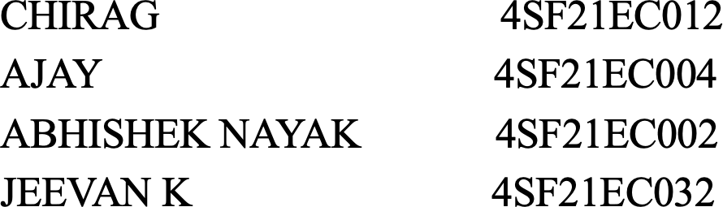
Department of Electronics & Communication Engineering
Project Proposal Presentation on
“GPS-Integrated Autonomous Surface Vehicle for Depth Mapping and
Environmental Water Testing”
By
Under the Guidance of
Mr. Praveen Kumar M
Assistant Professor,
Department of Electronic and communication Engineering
2024-25
SCEM-Electronic and Communication Engineering
17-12-2024

Slide 2
Introduction
Water survey teams face challenges such as labor-intensive methods, difficult access to remote areas, and inconsistent data quality.Traditional methods often miss trends and can disturb ecosystems. Limited resources and the need for advanced technology expertise add to the difficulties. Autonomous systems can significantly improve efficiency and accuracy in water resource management
SCEM-Electronic and Communication Engineering
17-12-2024

Slide 3
Problem Statement
Accurate and detailed information about water bodies is crucial for various applications, including environmental monitoring, hydrographic surveys, aquaculture management, and recreational activities.Traditional methods of gathering water depth and quality data can be labour-intensive, time-consuming, and limited in scope. Autonomous systems offer a promising solution to these challenges by enabling continuous, high-resolution data collection with minimal human intervention.
SCEM-Electronic and Communication Engineering
17-12-2024

Slide 4

Current method
Traditional method is used where a team of researchers go to targeted spot and collect water sample for testing.
Uses high end boats for under water survey in oceans but it is not applicable for small water bodies like river , lake etc.
Professional team of divers has been used for bathymetric survey.
Time consuming and investment.
SCEM-Electronic and Communication Engineering
17-12-2024

Slide 5
Project Objectives
Autonomous navigation system.
Accurate under water bathymetry, Provide accurate 3d mapping of underwater structures.
The system should be able to sustain the high currents.
Accurate data analysis of water quality,
No manual interference and multipurpose usability.
SCEM-Electronic and Communication Engineering
17-12-2024

Slide 6
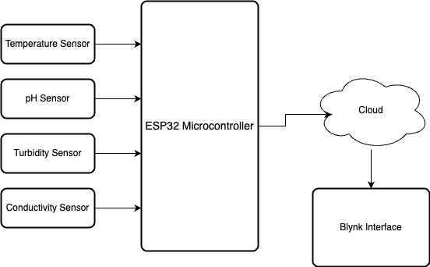
METHODOLOGY
SCEM-Electronic and Communication Engineering
17-12-2024

Slide 7
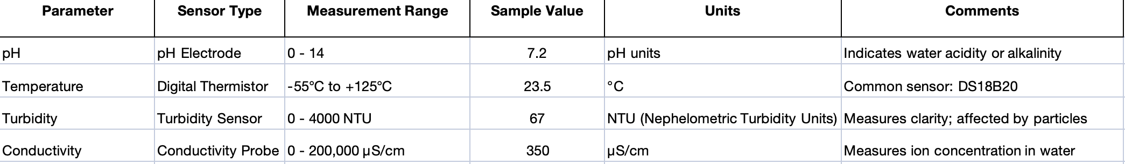
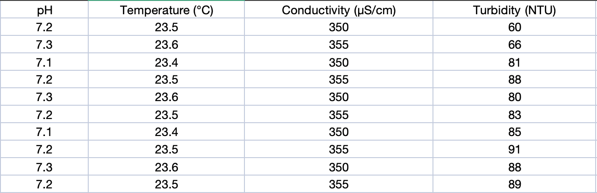
WATER QUALITY TESTING
SCEM-Electronic and Communication Engineering
17-12-2024

Slide 9
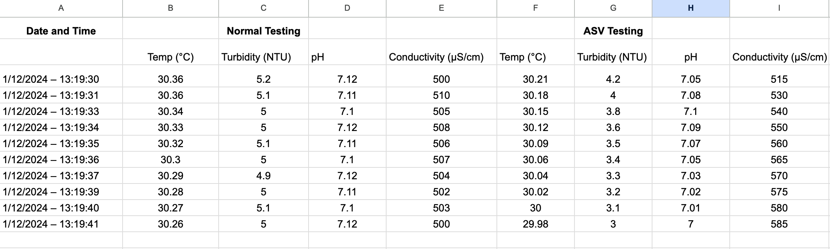
WATER QUALITY TESTING
COMAPARISION TABLE
SCEM-Electronic and Communication Engineering
17-12-2024

Slide 10
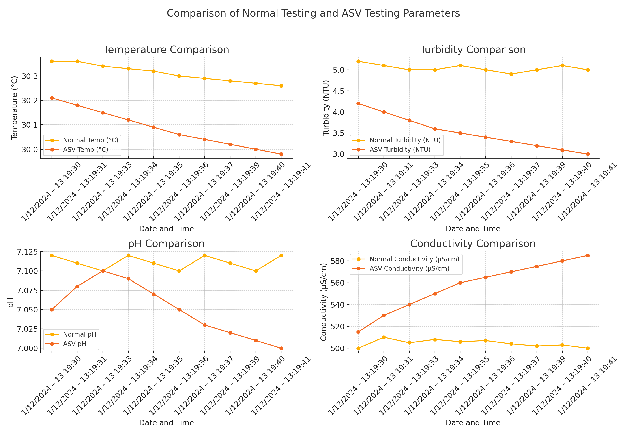
WATER QUALITY TESTING
SCEM-Electronic and Communication Engineering
17-12-2024

Slide 11
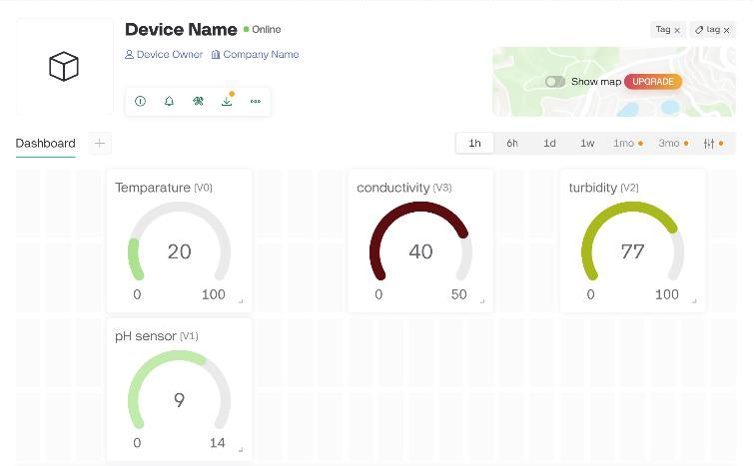
WEB INTERFACE
SCEM-Electronic and Communication Engineering
17-12-2024

Slide 12
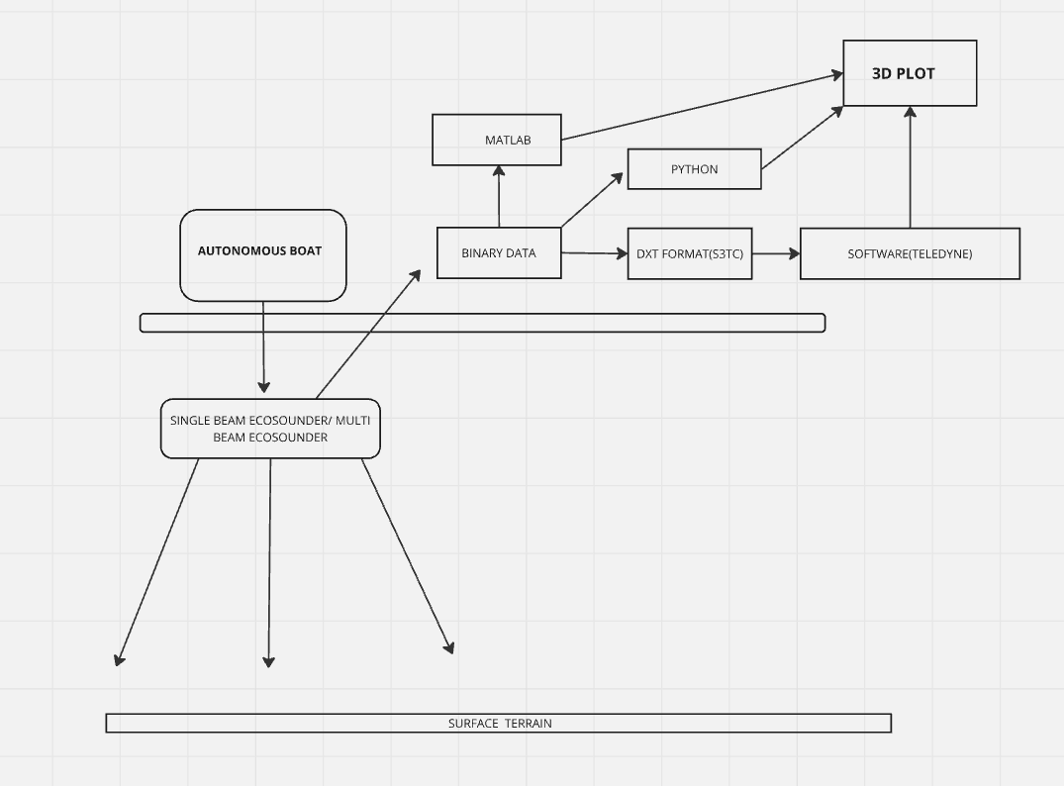
METHODOLOGY
SCEM-Electronic and Communication Engineering
17-12-2024

Slide 13
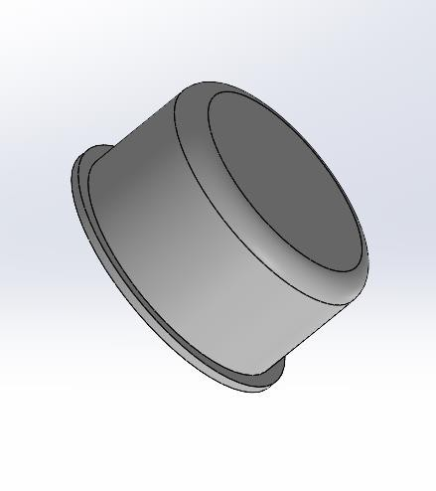
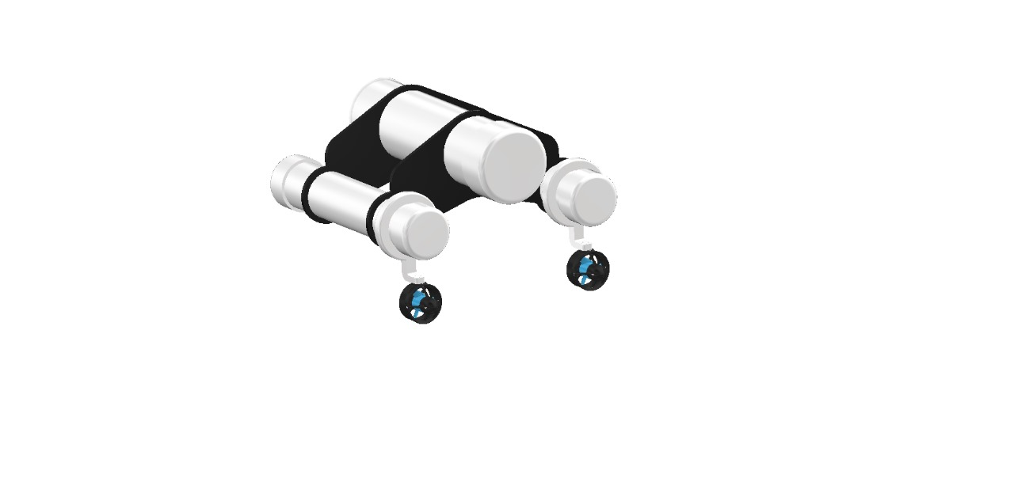
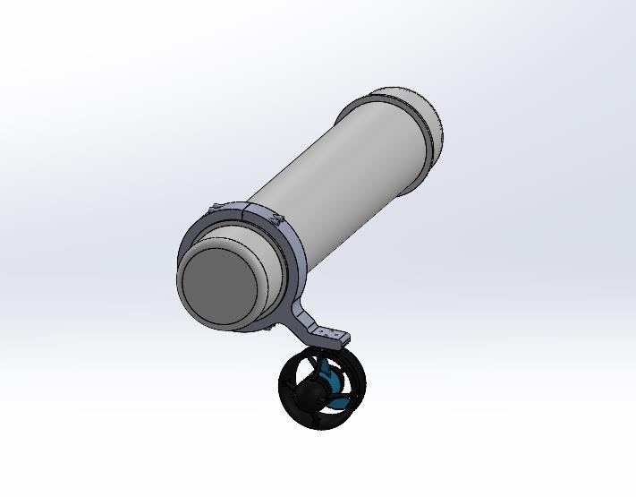
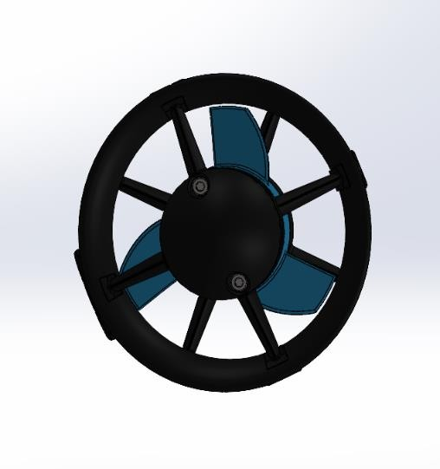
Progress Achieved
CAD Design
SCEM-Electronic and Communication Engineering
17-12-2024

Slide 14
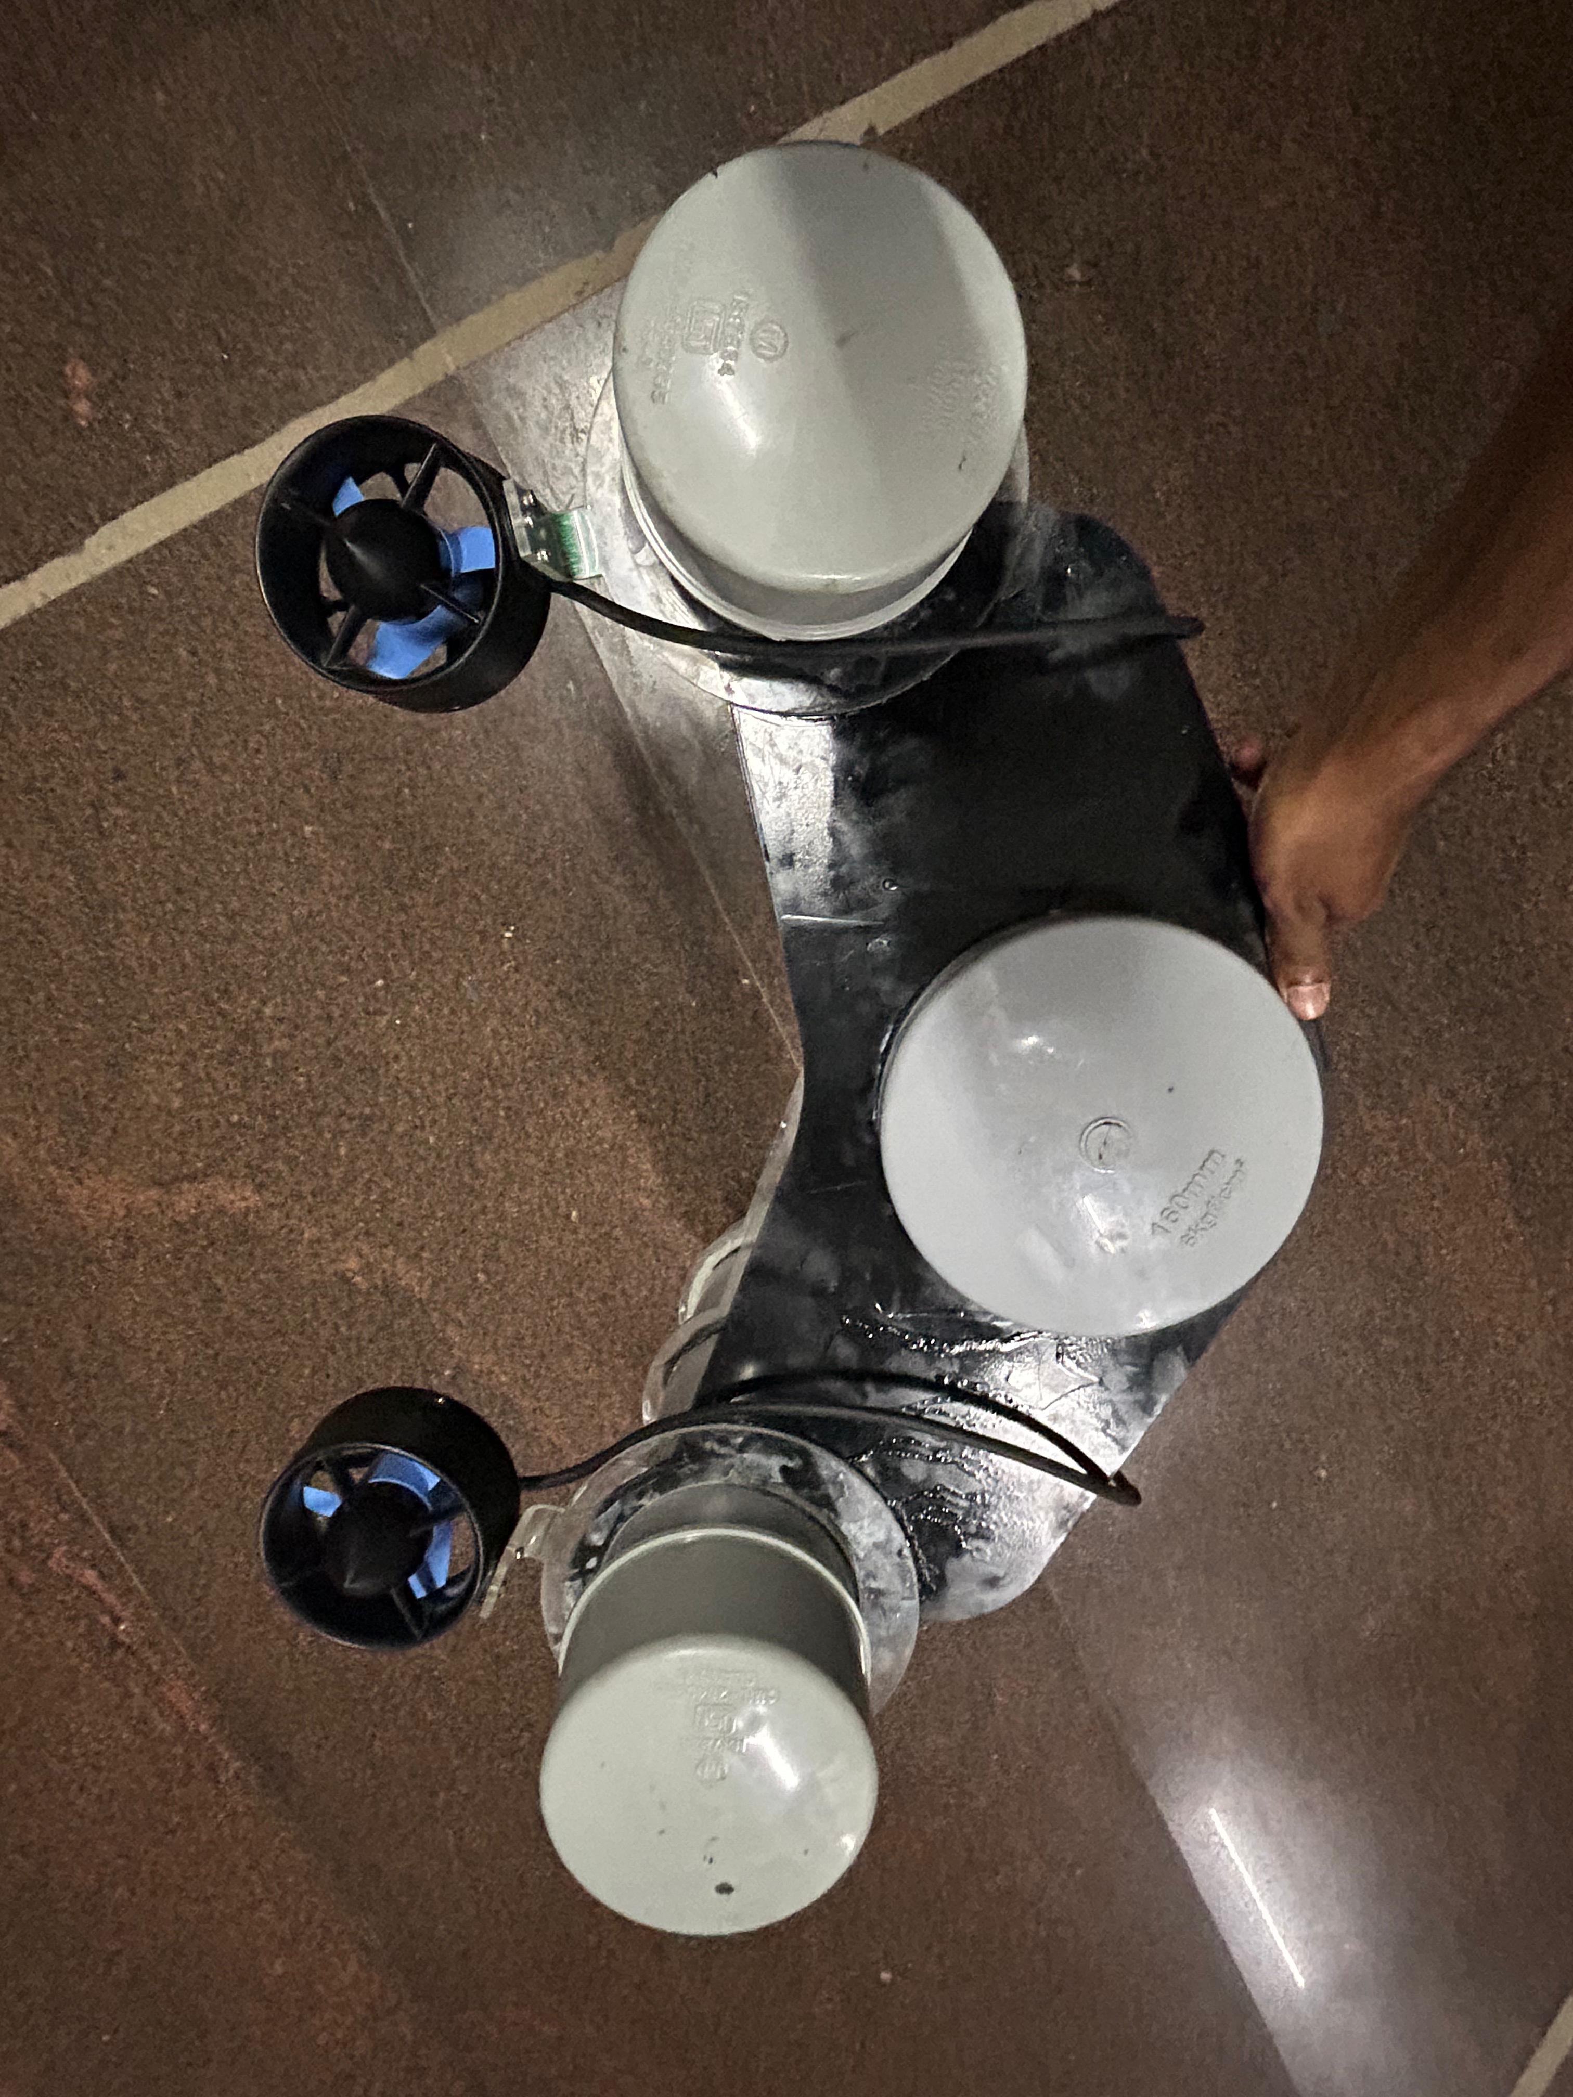
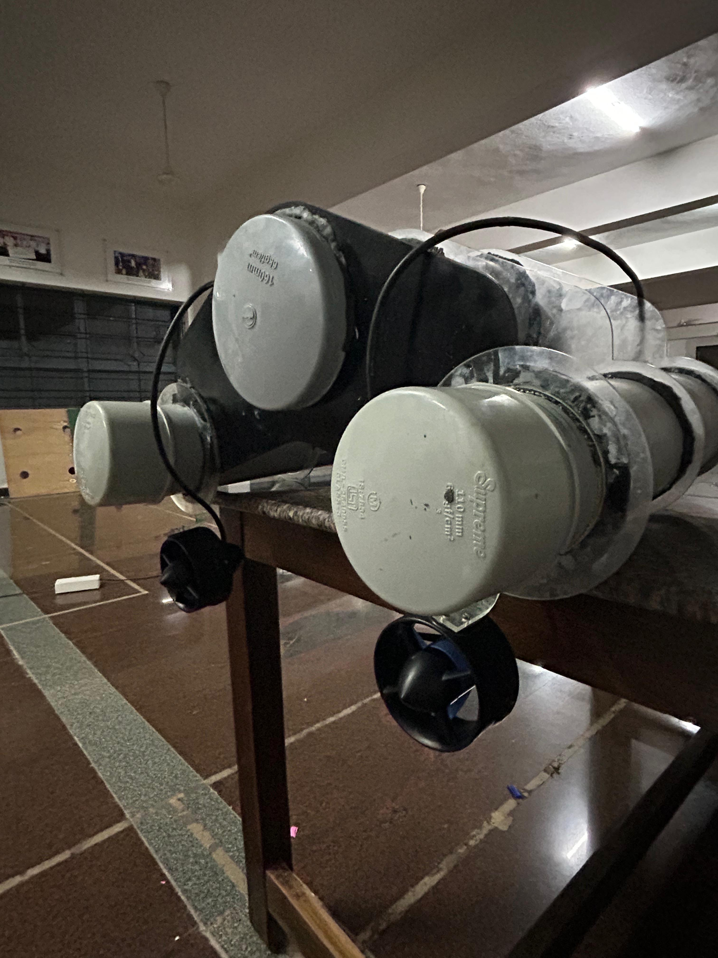
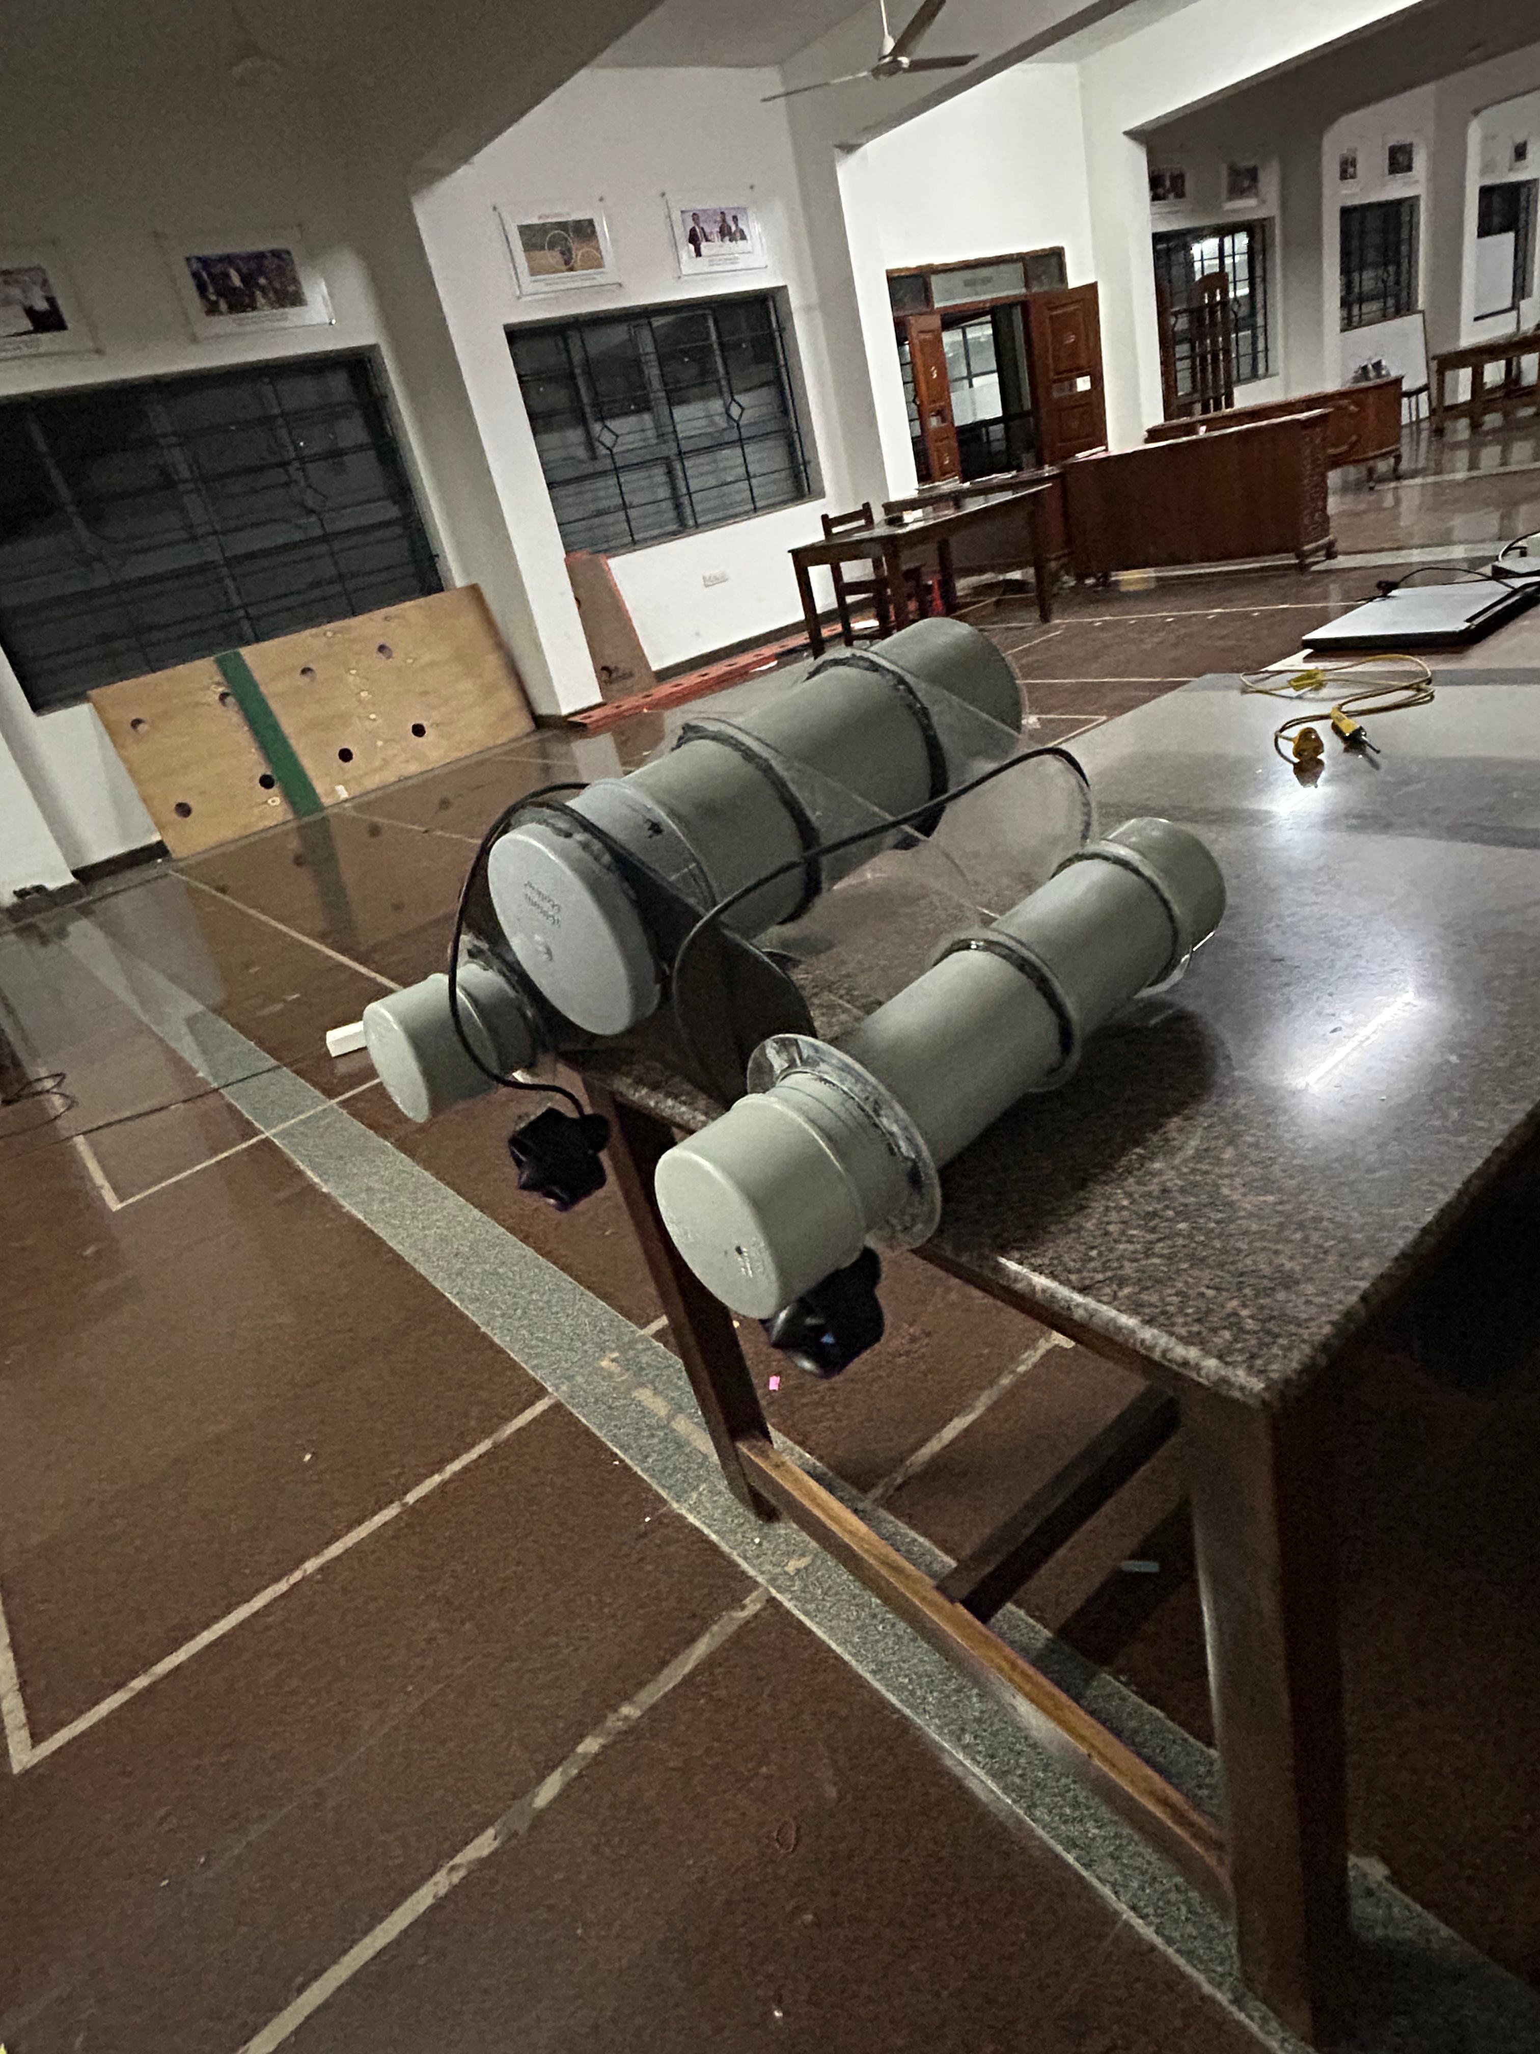
Progress Achieved
SCEM-Electronic and Communication Engineering
17-12-2024

Slide 15
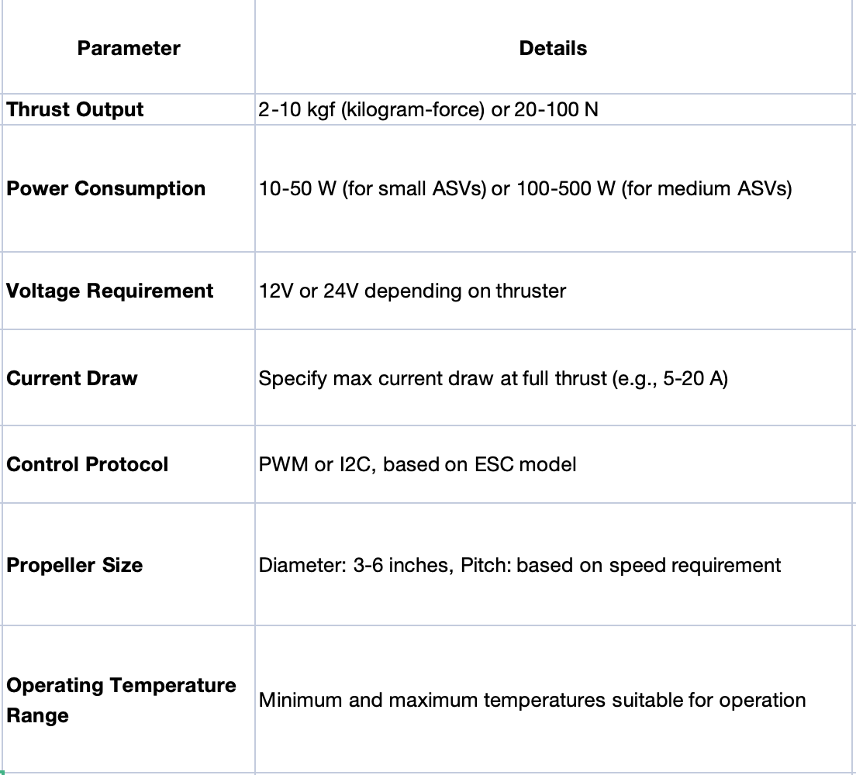
Progress Achieved
Thruster Specification
SCEM-Electronic and Communication Engineering
17-12-2024

Slide 16
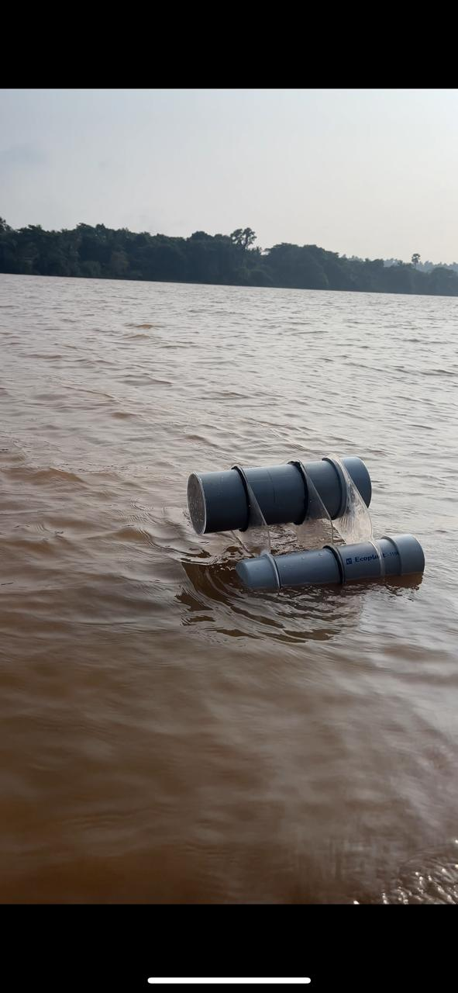
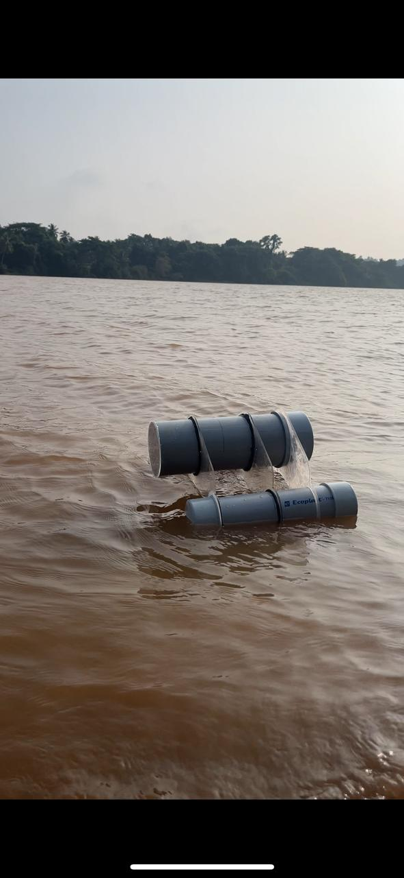
Progress Achieved
ASV Testing
SCEM-Electronic and Communication Engineering
17-12-2024

Slide 17
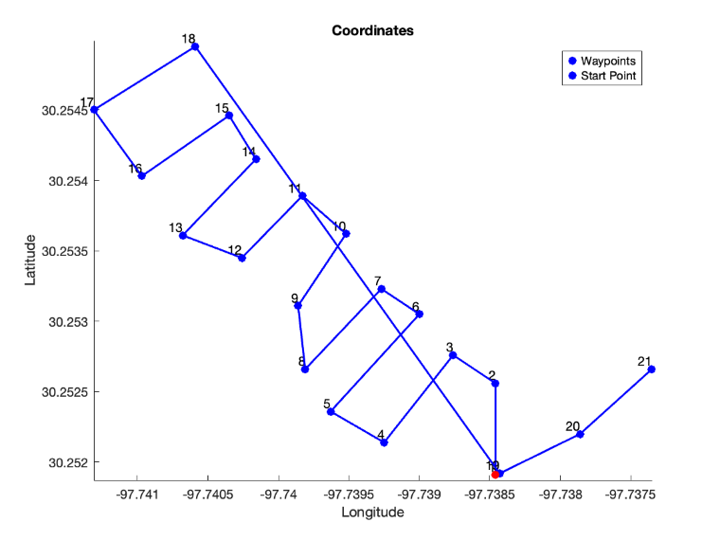
MAPPING
SCEM-Electronic and Communication Engineering
17-12-2024

Slide 18
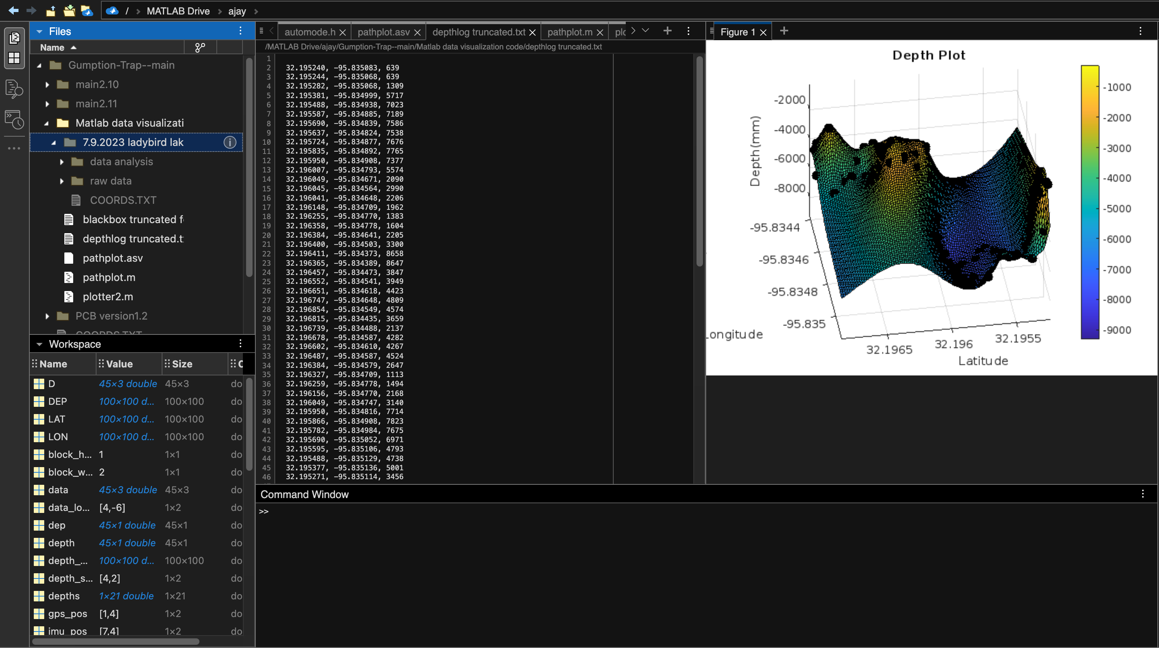
BATHYMATRIC MAPPING PLOT
SCEM-Electronic and Communication Engineering
17-12-2024

Slide 19
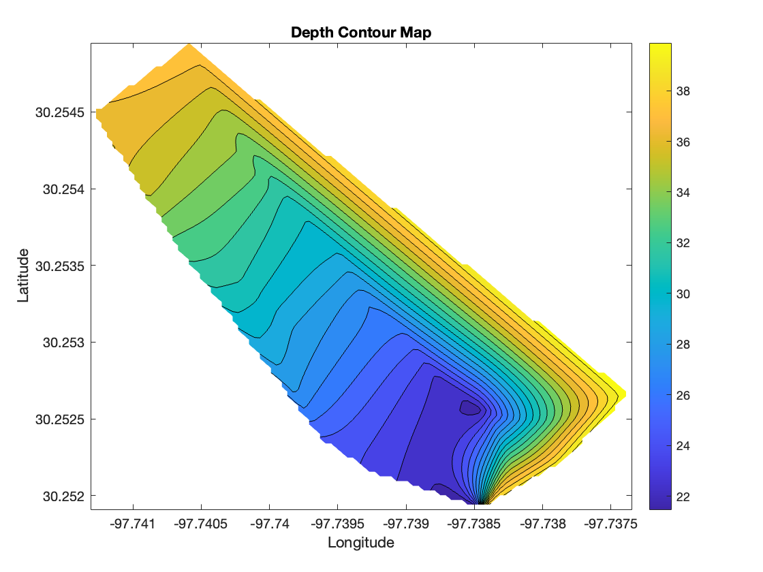
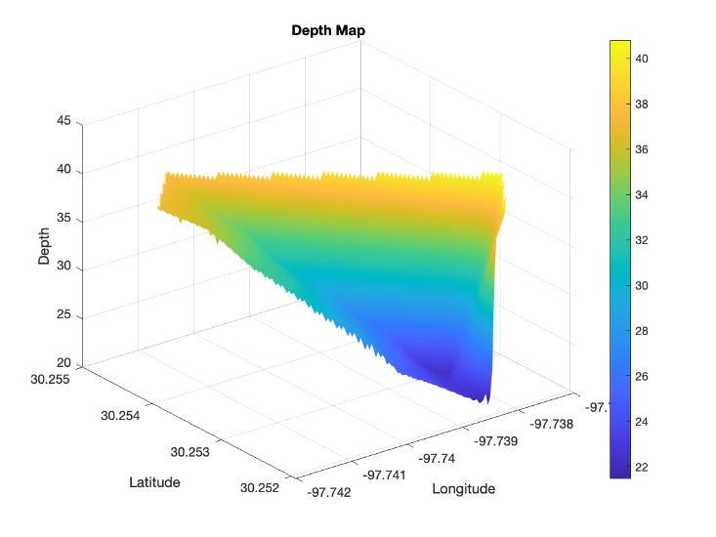
BATHYMATRIC MAPPING PLOT
SCEM-Electronic and Communication Engineering
17-12-2024

Slide 20
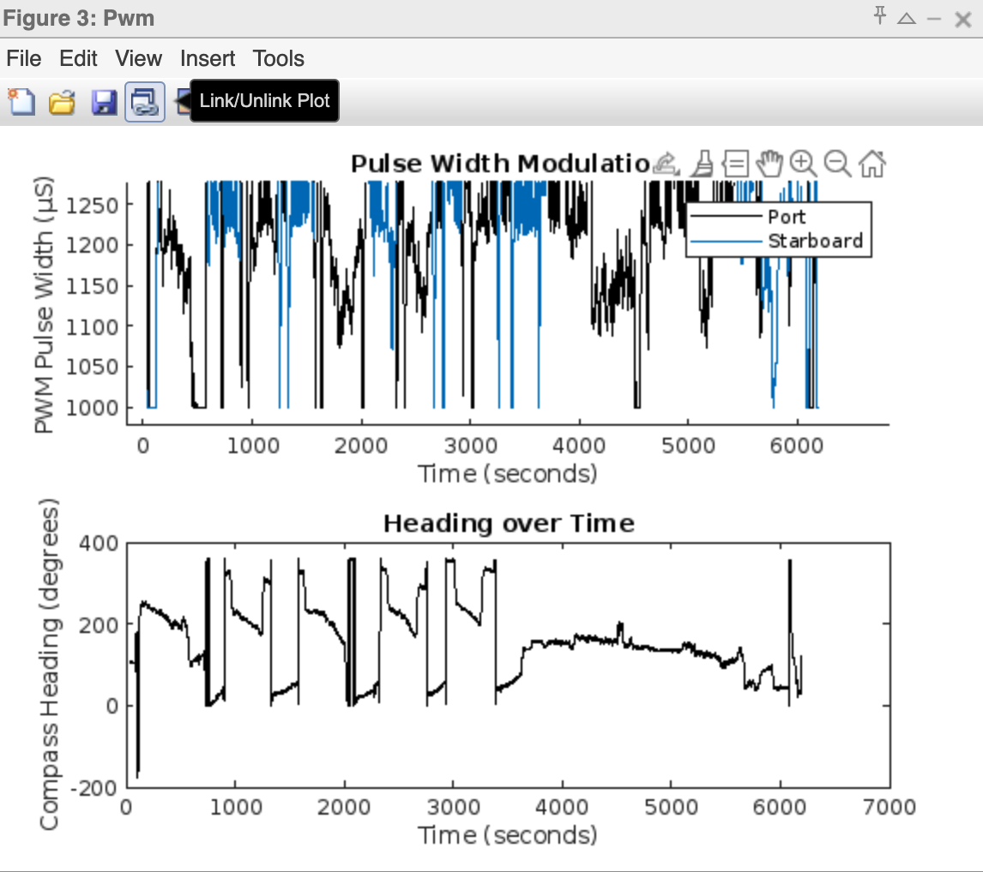
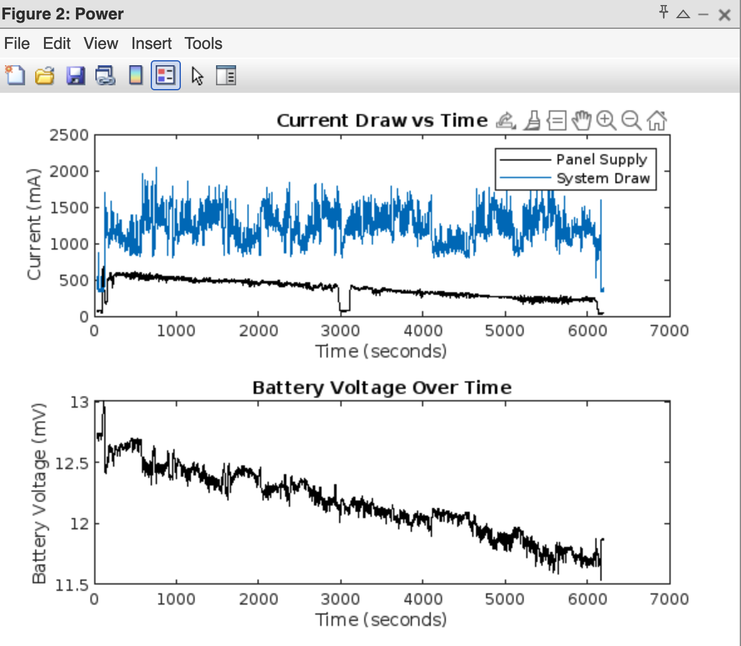
BATHYMATRIC MAPPING PLOT
SCEM-Electronic and Communication Engineering
17-12-2024

Slide 21
References
Smith, D. A. N. I. E. L., L. I. N. D. A. Cross, J. A. R. E. D. Rivet, and S. T. E. V. E. N. Hall. "Design of a semi-autonomous boat for measurements of coastal sedimentation and erosion." Proceedings of the International Association of Hydrological Sciences 367 (2015): 447- 454.
Salalila, Aljon. Autonomous Real-Time Water Quality Monitoring System. Washington State University, 2021.
Salalila, Aljon. Autonomous Real-Time Water Quality Monitoring System. Washington State University, 2021.
Meuzelaar, Tom, Shannon D. Zahuranec, and James P. Jonas. "Innovative data collection and
management strategies for improved water treatment efficiency."
Meuzelaar, Tom, Shannon D. Zahuranec, and James P. Jonas. "Innovative data collection and management strategies for improved water treatment efficiency."
Campbell, M. D., R. Schalla, and D. R. Newcomer. Accuracy and cost effectiveness of manual and automated water-level monitoring technology. No. PNL-7566. Pacific Northwest National Lab.(PNNL), Richland, WA (United States), 1991.
Saleh, Thomas, and Madeline Stanley. "Real-Time Water Quality Monitoring." (2023).
SCEM-Electronic and Communication Engineering
17-12-2024

Slide 22
Thank You
SCEM-Electronic and Communication Engineering
17-12-2024

